Slide 1



Session 1:
Values and Goal-Setting

Slide 2


Introduction to Elevate
The importance of living out our values
How to improve our self-esteem and why it is important
Improving communication with our parents/guardians
The role that media plays on our self-esteem
How to focus our actions on the future
How to be a better leader

Slide 3
Ground Rules
E- Everything is confidential
L- Listen and only one person talks at a time
E- Encourage others’ ideas and be respectful
V- Value others’ thoughts and right to pass
A- Always use positive language and avoid put-downs
T- Try! Participate!
E- Enjoy yourself!

Slide 4

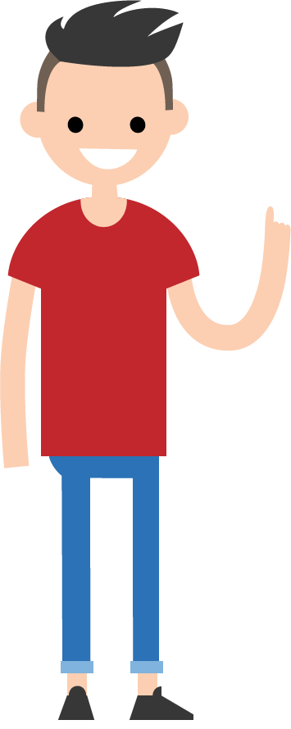

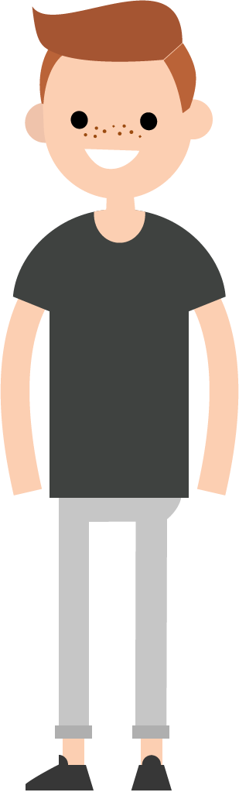
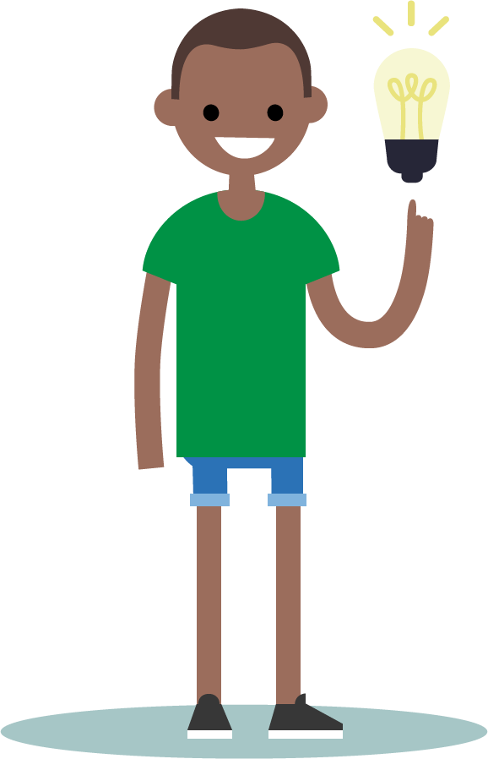
Brainstorming
Notes:
Can someone define ‘brainstorming’ in their own words?

Slide 5
What are some issues that
8th graders experience?
Notes:
Let’s try a quick brainstorming idea now. We will take the next minutes to shout out any teen issues you think 8th graders experience. After one minute, we will stop and see which ones we think people at this school experience the most.

Slide 6
Introduction to Values
Would you rather have $5 or $100?
Would you rather spend three hours reading or exercising?
Would you rather graduate from high school or have the same partner for the rest of your life?
Would you rather have a child or work your dream job?
How did you determine which choice to make?
Why were some decisions harder than others?

Slide 7
What is a value?

Slide 8
Values
We make our decisions based off of our VALUES
We develop values by experiences, family,
friends, and media
Each person has a different set of values

Slide 9
A person who values their talent may commit to practicing several times a week
A person who values their schooling may have not missed any days of school or assignments
A person who values their health may eat healthy, exercise regularly, and avoid drugs and sexual activity
Can your values change?

Slide 10
My Top 4
Read through the following values and rank them in importance to you.
#1 is your most important value to #8 is less important.
If some values are not important to you at this moment of your life, place them in the “Maybe One Day” section.
Your values are a reflection of YOU so take the time to really think about each one.

Slide 11
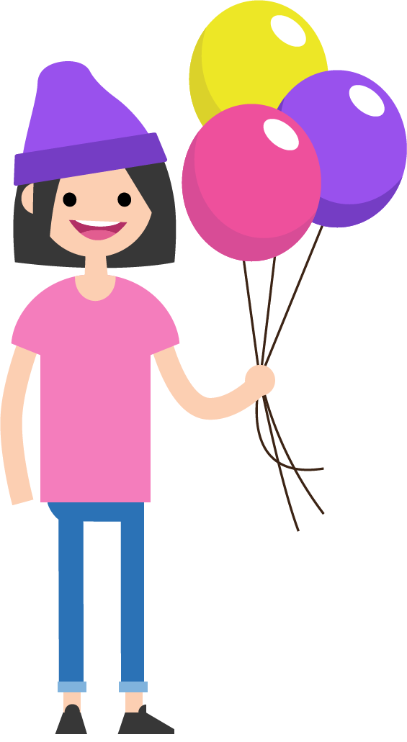
Up In the Air

Slide 12
Up in the Air
It is challenging to grow up with so many distractions from friends, parents, media, and school.
DO WHAT? Explain the following 4 bullets:
      Are you juggling the right things in your life?
      Are you distracted by too many of the wrong things?
      Are you succeeding at juggling things in your life?
      Do you need to work on yourself?

Slide 13
What is a goal?

Slide 14
Write down a goal.

Slide 15
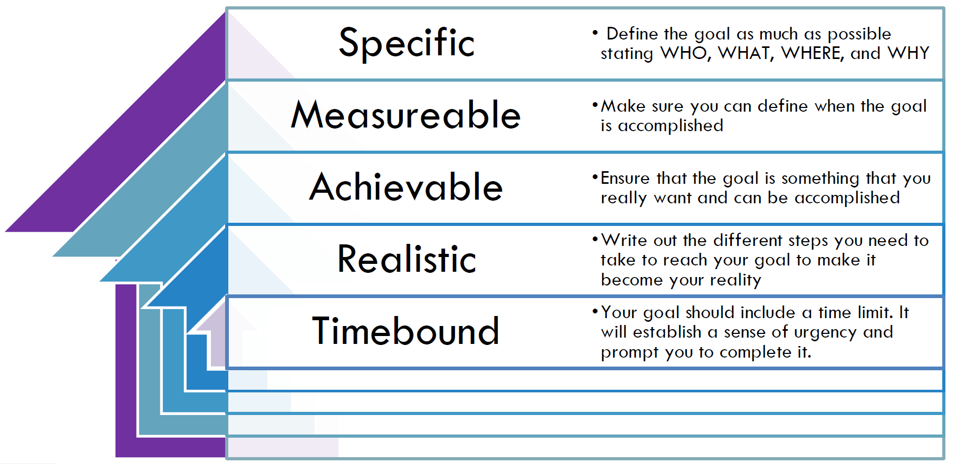
SMART GOALS

Slide 16
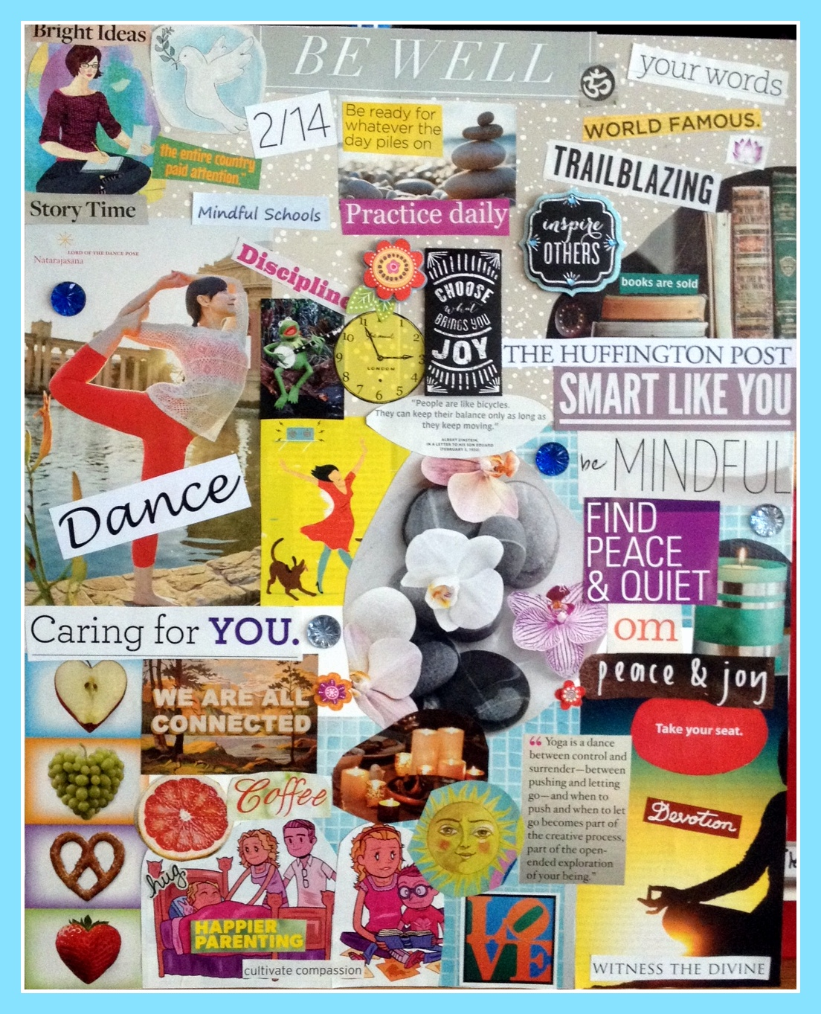
Vision board

Slide 17

HOMEWORK

